Slide 1
CHAPTER 9 COMPUTER LANGUAGES

Slide 2
Introduction
Human languages are known as natural languages.
Unfortunately, computers can not understand natural languages (English, Gujarati, Spanish,.. etc),
as a result we must communicate with computers using computer languages (programming languages)
Programming languages can be used to create programs that control the behavior of a computer and serve any purpose
A programming language is a set of rules that provides a way of telling a computer what operations to perform.

Slide 3
Introduction
English is a natural language. It has words, symbols and grammatical rules.
A programming language also has words, symbols and rules of grammar.
The grammatical rules are called syntax.
Each programming language has a different set of syntax rules.

Slide 4
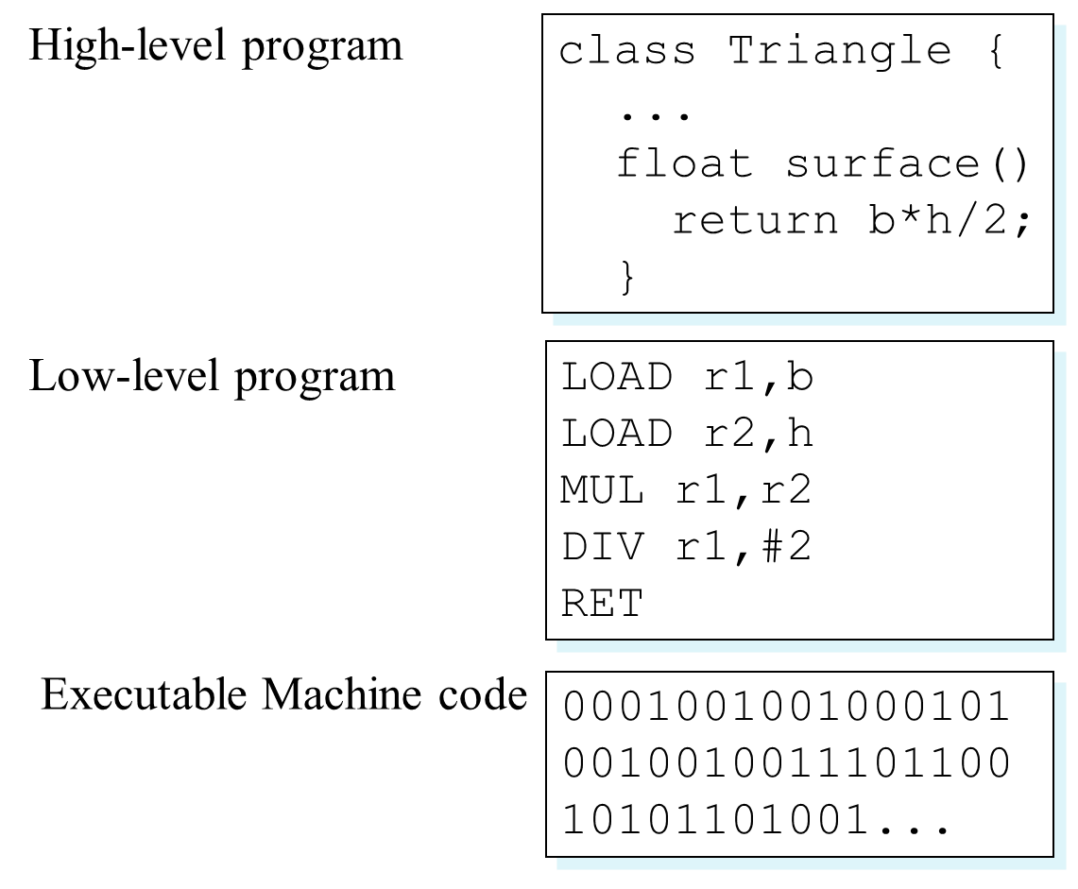
Levels of Programming Languages

Slide 5
Architecture
Computer understand only binary language (0 or 1) .
Binary language also known as machine or low level language
All the instructions given in binary form only – hard to understand by people
High-level language were developed

Slide 6
Classification of Programming Languages
Programming Language
Machine Language
Assembly Language
High-level Language
Low-level languages

Slide 7
Generations of Programming Languages
Computer languages has the same history as the computers itself history,
There are five generations of languages when programming method and techniques could be developed as far as development in hardware occurred.

Slide 8
First Generation (1GL) – Machine Language
First-generation language was machine language
the level of instructions and data that the processor is actually given to work on binary numbers 0s and 1s.
In the 1940s and 1950s, computers were programmed by scientists sitting before control panels equipped with toggle switches so that they could input instructions as strings of zeros and ones.

Slide 9
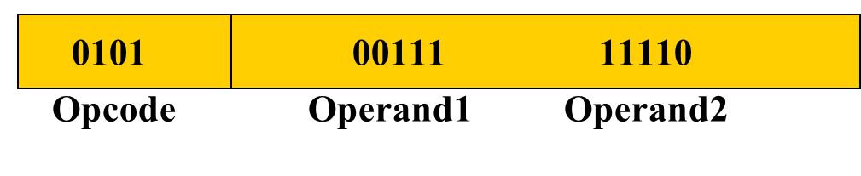
(1GL) – Machine Language
Machine language Format
Operation code – instruct computer what functions are to be performed (such as addition or subtraction).
Operands – instruct the computer where to find or store the data on which the desired operation is to be performed
Machine language is machine dependent as it is the only language the computer can understand.
Very efficient code but very difficult to write.

Slide 10
(1GL) – Machine Language
Advantages:
Translation Free:
computer can directly execute without the need for conversion
High Speed:
Since no conversion is needed, applications developed using machine languages are extremely fast
Ex. Space control system, nuclear reactors and chemical processing

Slide 11
(1GL) – Machine Language
Disadvantages:
Machine Dependent
Based on computer architecture,
application developed for one type of computer may not run on others
Complex Language
Difficult to read and write
Error Prone
Since programmer has to remember all the opcode and the memory locations, it is bound to be error prone
Tedious
Programming becomes too complex to modify

Slide 12
Second Generation (2GL) – Assembly Language
By the late 1950s, this language had become popular.
Known as Symbolic language
Assembly language consists of letters of the alphabet.
This makes programming much easier than trying to program a series of zeros and ones.
An assembler converts the assembler language statements into machine language

Slide 13
Second Generation (2GL) – Assembly Language
The general format of Assembly Language:
Label
Opcode
Operands
Comment
BEGIN
ADD
A, B
Add B; to A;

Slide 14
Second Generation (2GL) – Assembly Language
Machine Language Program
Assembler
Assembly Program (Source Code)
Error Messages (if any)

Slide 15
Second Generation (2GL) – Assembly Language
Advantages:
Easy to understand and Use
Less Error Prone
Efficiency
Faster compare to high-level language programs
More control on hardware

Slide 16
Second Generation (2GL) – Assembly Language
Disadvantages:
Machine Dependent
Different computer have their own assembly languages
Harder to learn
Slow development time
Less efficient
No standardization
No support for modern software engineering technology

Slide 17

Third Generation (3GL)-High-level Language
Closer to English but included simple mathematical notation.
Programmer do not need to know how computer works in detail.
Programmer can write program by learning syntax of language.
High level language must use interpreter, compiler or translator to convert human understandable program to computer readable code (machine code).

Slide 18
Third Generation (3GL)-High-level Language
Many high level languages have appeared since Fortran II the most widely used have been:
COBOL Business applications
FORTRAN Engg & Scientific Applications
PASCAL General use and as a teaching tool
C & C++ General Purpose – currently most popular.
PROLOG Artificial Intelligence
JAVA General all purpose programming

Slide 19
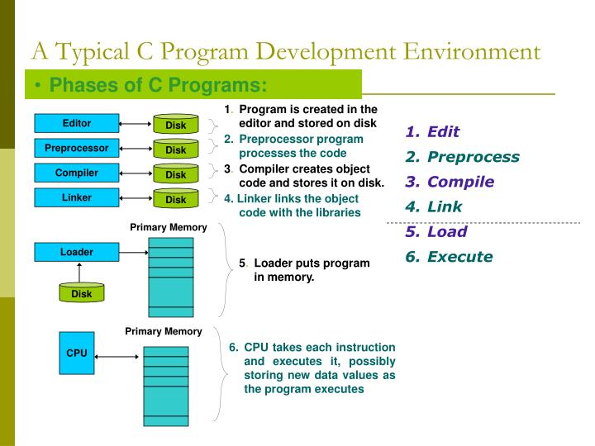

Slide 20
Compiler
Language translator: convert high-level language into machine language
Compiler replaces single high-level statement with a series of machine language instructions
Target Language Program (Machine object code)
Compiler
High-level Language program (Source code)
Error Messages (if any)

Slide 21
Compiler
Program compilation: Compiler translates whole program into an equivalent machine language program
Once the program has been compiled, the resulting machine code (object code) saved separately, which can be run on its own at any time
Once the object code is generated, there is no need of actual source code
If source code is modified – necessary to recompile the program
For each high-level language, a separate compiler is required

Slide 22
Interpreter
Language translator: convert high-level language into machine language
Unlike compiler: it translates a statement of program and executes immediately, before translating next statement
Results of the expected statement
Translates and Executes Statement by Statement
High-level Language program (Source code)
Error Messages (if any)

Slide 23
Linker
An application usually consists hundreds, thousands or even million of lines of code
Code divided into logical groups and stored into different modules
So debugging and maintenance becomes easy
Each module can be modified and compiled independently
Linker links several object modules and libraries to form a single program

Slide 24
Linker
Source file
Compiler
Object file
Source file
Object file
Executable file
Compiler
Linker
Source file
Object file
Program Library
Compiler

Slide 25
Loader
Part of operating system that brings an executable file residing on the disk into the memory and starts running
Four basic tasks of loader:
Allocation: allocates memory space for programs
Linking: combines two or more separate object programs and supplies the information needed to allow references between them
Relocation: prepares a program to execute properly from its storage area
Loading: place data and machine instructions into the memory

Slide 26
Loader
Types of loader:
Absolute Loader:
Loads the file into memory at the location specified by the beginning portion (header) of file and then passes control to program
If memory space specified by header is currently in use, execution cannot be processed
User must wait until requested memory becomes free
Relocating loader:
Loads the program in memory, altering the various addresses as required to ensure correct referencing

Slide 27
Advantages of High-level Languages
Readability
Easy to read, write and maintain
Machine independent
Easy debugging
Easier to maintain
Low development cost
Easy documentation

Slide 28
Disadvantages of High-level Languages
Poor control on hardware
Less efficient
Process of translation increases the execution time of an application

Slide 29
Popular High-level Languages
FORTRAN
COBOL
BASIC
PASCAL
C
C++
JAVA
PROLOG
LISP

Slide 30
Fourth Generation (4GL)
4GLs have simple, English-like rules, commonly used to access databases
4GLs are divided into three categories:
Query Languages: allow user to retrieve information from databases (ex. SQL)
Report Generators: produce customized reports using data stored into database
Application Generators: the user writes programs to allow data to be entered into the database

Slide 31
Fourth Generation (4GL)
Advantage:
User can create an application in a much shorter time for development and debugging than with other programming languages
Disadvantage:
Program need more disk space and large memory capacity compared to 3GL program

Slide 32
Fifth Generation Languages (5GL)
Though no clear definition at present, natural language programs generally can be interpreted and executed by the computer with no other action by the user than stating their question.
User will free from learning any programming language to communicate with computes
Programmers may simply type the instruction or tell the computer via microphones what is needs to do
Limited capabilities at present.

